Slide 1

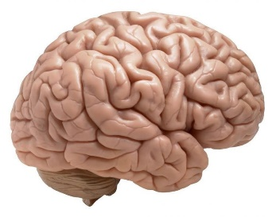
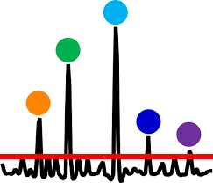

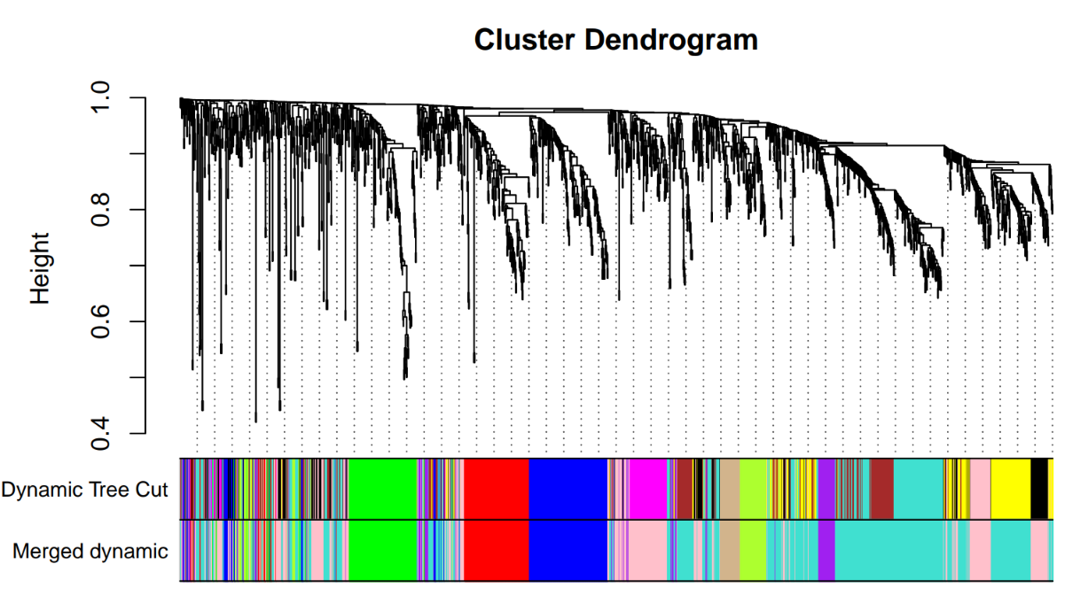
a
BrainD-EV extraction
Mass spectrometry
BioFluid extraction
Fresh Frozen
Post-mortem
human brain
(NC and AD)
PF

